Slide 1
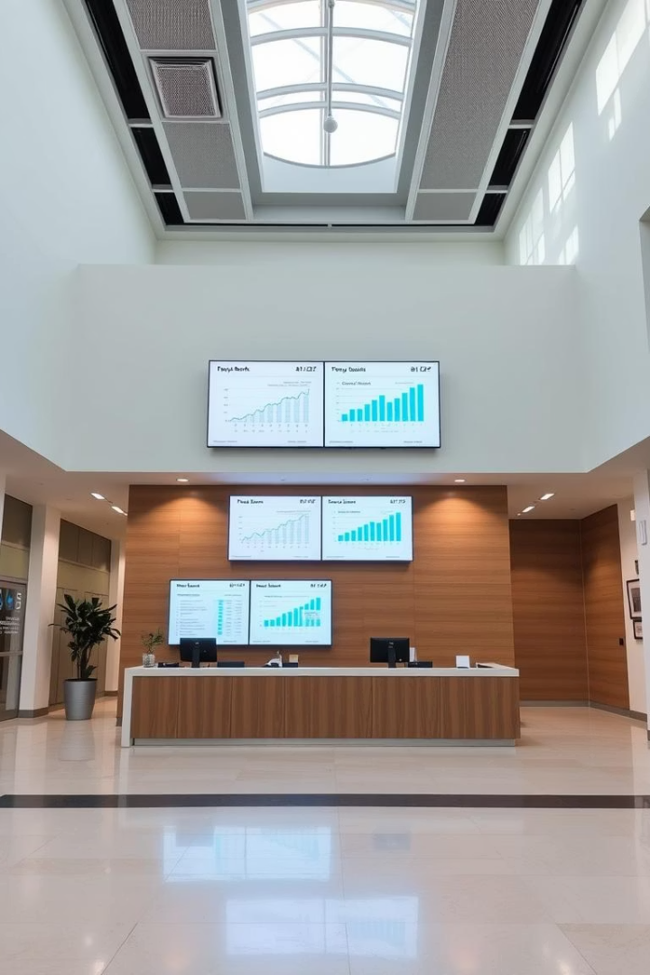
Banking Risk Analytics Portfolio Project: An Overview
This project analyzes customer loan risk profiles from start to finish.
Utilizing Python, SQL, stats, and PowerBI, it helps banks reduce losses.

Slide 2

Project Goals and Objectives
Identify Risk Factors
Analyze key risks across customer income segments.
Predict Loan Defaults
Develop models to forecast potential defaults accurately.
Actionable Insights
Help improve credit scoring and approval decisions.
Risk Management
Enhance strategies minimizing financial institution losses.

Slide 3
Data Collection and Preparation
Data Sources
Data Cleaning
Data Quality
Loan applications
Handle missing values
Validate against defined rules
Credit bureaus
Remove duplicates with >95% similarity
Ensure integrity for reliable analysis
Transaction histories
Fix inconsistencies and outliers

Slide 4

Exploratory Data Analysis (EDA)
Statistical Analysis
Calculate summary stats and correlations.
Data Visualization
Create charts to identify trends and patterns.
Customer Segmentation
Group customers by shared traits for targeted insights.
Example Insight
Visualize income, credit score, and default correlations.

Slide 5





Technology Stack
Python
SQL
PowerBI
Pandas, NumPy, Scikit-learn for data tasks and seaborn.
Extract and transform data from MySQL and PostgreSQL.
Create interactive dashboards and reports.
Excel
Organize, analyze, visualize, automate, calculate, report.

Slide 6

Earning Segment Analysis
1
High-Income Earners
Risk from investments and volatile assets.
2
Middle-Income Earners
Risk tied to job stability and expenses.
3
Low-Income Earners
Risk related to debt and credit access.

Slide 7





Risk Mitigation Strategies
Tailored Approaches
Customize plans for each earning segment.
Early Warning Systems
Detect defaults before they happen.
Loan Term Adjustments
Recommend interest rate and term changes.
Resource Optimization
Allocate risk management efforts efficiently.

Slide 8
PowerBI Dashboard and Reporting
Interactive Dashboards
Customizable Reports
User-Friendly Interface
Secure Access
Drill down into specific customer data points.
Role-based permissions to protect data.
Real-time visualization of risk indicators.
Easy access for all stakeholders.

Slide 9

Conclusion: Impact and Future Directions
Project Impact
Future Growth
Improves risk management and reduces losses.
Expand data sources, improve models, enhance strategies.
Industry Contribution
Promotes data-driven decisions for financial stability.

